Slide 1
Programming in C

Slide 2
Week 5
Pointers

Slide 3
The advantage of using pointers in C
Pointers are used i.a. to :
return (multiple) values from a function (Week5)
more efficiently handle arrays (Week7)
more efficiently handle structures (Week8)

Slide 4

Pointer
A pointer is a variable whose value is the address of another variable, i.e., direct address of the memory location
Declare a pointer before using it to store any variable address
int c;
int *p; /* declare a pointer */
p = &c; /* assign the address of c to p */
*p = 5; /* dereferencing the pointer p */
Notes:
Another way to explain pointers with box and arrow

Slide 5
How to use pointers
memory
…
128
124
120
116
112
108
104
int c;
c
X
5
= 10
int *p;
p = &c;
p
= 124
c = 10;
*p = 5; //dereferencing

Slide 6
How to use pointers
memory
x = 1
y = 2
z[9]
z[0]
ip
X
0
int x = 1, y = 2, z[10];
int *ip; /* ip is a pointer to int */
ip = &x; /* ip now points to x */
y = *ip; /* y now is 1 */
*ip = 0; /* x is now 0 */
ip = &z[0]; /* ip now points to z[0] */
X
1

Slide 7
Example of using pointers
int *ptr1, m = 300;
float *ptr2, f = 300.60;
ptr1 = &m;
ptr2 = &f,
printf (“m = %d , address = %p, value = %d\n”, m, &m, *(&m));
printf (“m = %d , address = %p, value = %d\n”, m, ptr1, *ptr1);
printf (“f = %f , address = %p, value = %f\n”, f, &f, *(&f));
printf (“f = %f , address = %p, value = %f\n”, f, ptr2, *ptr2);
Notes:
Guess what is the output

Slide 8
Example of using pointers
#include <stdio.h>
int main()
{
int x;
scanf(“%d”, &x); // scanf uses pointers
printf(" x = %d\n", x); printf(" Address of x = %p\n", &x);
return 0;
}
#include <stdio.h>
int main()
{
int *ptr;
int x;
ptr = &x;
*ptr = 0;
printf(" x = %d\n", x);
printf(" Address of x = %p\n", *ptr);
return 0;
}

Slide 9
Pointers and arrays (week7)
#include <stdio.h>
int main()
{
int arri[] = {1, 2 ,3};
int *ptri = arri;
char arrc[] = {1, 2 ,3};
char *ptrc = arrc;
printf("sizeof arri[] = %d\n", sizeof(arri));
printf("sizeof ptri = %d\n", sizeof(ptri));
printf("sizeof arrc[] = %d\n", sizeof(arrc));
printf("sizeof ptrc = %d\n", sizeof(ptrc));
return 0; }

Slide 10
Pointer arithmetic (week7)
130
128
127
126
125
124
123
122
121
120
pc+1
pc
char c = ‘x’; // 1 byte
int a = 10; // 4 byes
int *pa = &a;
char *pc = &c;
pa++; // increment pa = pa + 1
pc++; //increment pc = pc + 1
pa+1
pa

Slide 11
Pointer arithmetic (week7)
104
108
p
p++
int *p, *q;
int a = 100;
p = &a;
p++;
q = p;
q--;
int *p;
char *q;
int a = 100;
p = &a;
p++;
q = (char*)p;
q--;
is (p == q) true?
is (p == q) true?
Notes:
Emphasize that type matters: e.g. long

Slide 12
Passing pointers to functions
void increment(int* p)
{
*p = *p + 1;
}
int main () {
int a;
a = 10;
increment(&a);
printf(“Address of a is: %p\n”, &a);
printf(“Incremented value of a is: %d\n”, a);
}
Notes:
Return pointers

Slide 13
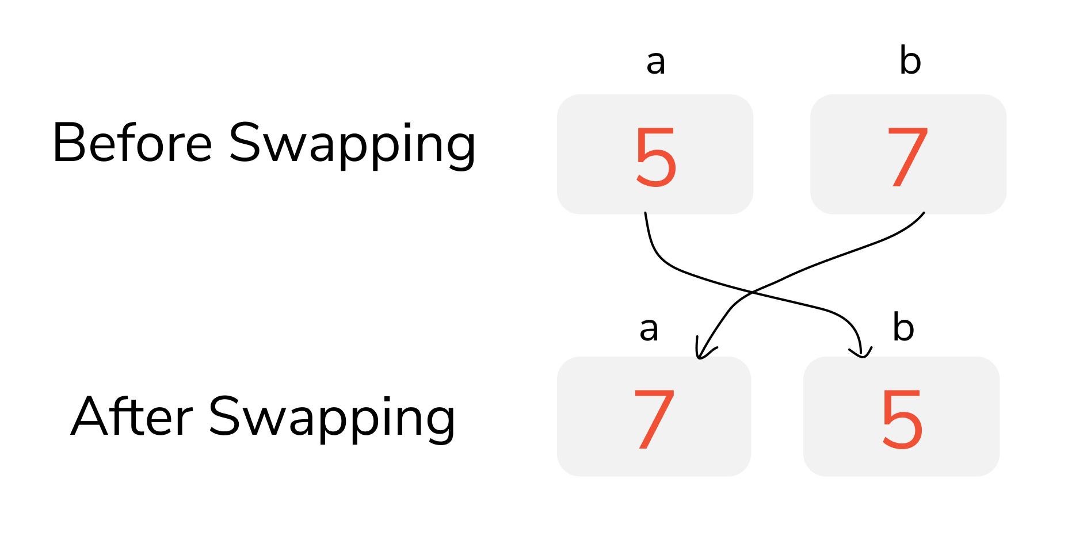
Exercise 1
Write a function to swap the value of two variables using pointers
Notes:
Give the prototype of the function

Slide 14
Exercise 2
Write the sort3 function to sort 3 numbers in ascending order by making use of pointers. The function should not make use of arrays.
 | int a | int b | int c
Before calling sort3 | 22 | 15 | 18
After calling sort3 | 15 | 18 | 22
Notes:
Give the prototype of the function

